Slide 1
Multithreading Across Different OS
By: Michael Emory, Thomas Kyte

Slide 2
Goals
Compare java and python
Different systems
Time taken
Memory used
Compare Windows 10 and Linux
Compare different systems

Slide 3
Specs
Processing types:
Linear
Threaded
Multiprocessing (Python only)
RNG algorithms used:
Linear Congruency
Lagged Fibonacci
Middle Square
Systems tested:
Dell Inspiron 16 Plus (Intel Core i7-11800H 24MB Cache, up to 4.6 GHz, 8 cores) (Windows 11)
Desktop PC (Intel Core i7-127700F 2.10 GHz) (Windows 10)
HP Pavilion Notebook (Intel Core i7-6500U 2.5 GHz) (Windows 10)
Raspberry Pi 4B (1.5 GHz) (Linux)
Raspberry Pi 400 (1.8 GHZ) (Linux)
Notes:
30 million numbers generated per a run

Slide 4
JAVA info
Linear
The RNG algorithms are executed one at a time.
Thread
Runs on one core

Slide 5
Python info
Linear
Thread
Runs on one core
Multiprocessing
Each process runs in its own core
Notes:
Thread: GIL
Global interpreter lock
restricts the threads and works as a single thread
Needed because of memory management by reference counter (when no more references in program memory is freed)
GIL not an issue in CPU focused programs is an issue in I/O programs

Slide 6
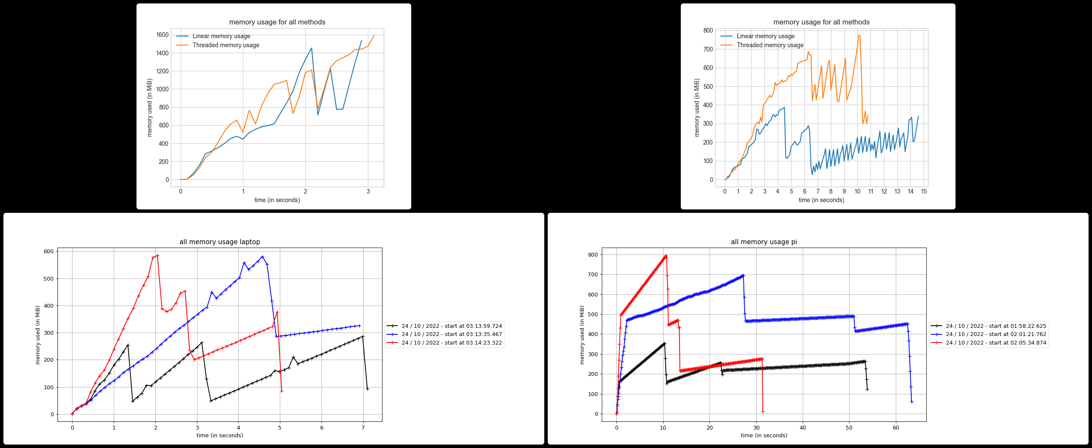
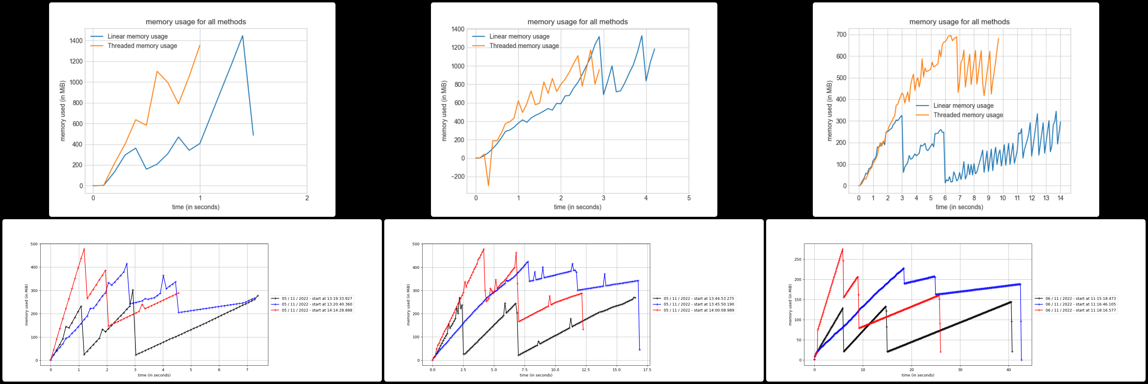
CPU Data
TK Laptop, Pi
ME Desktop, Laptop, Pi

Slide 7
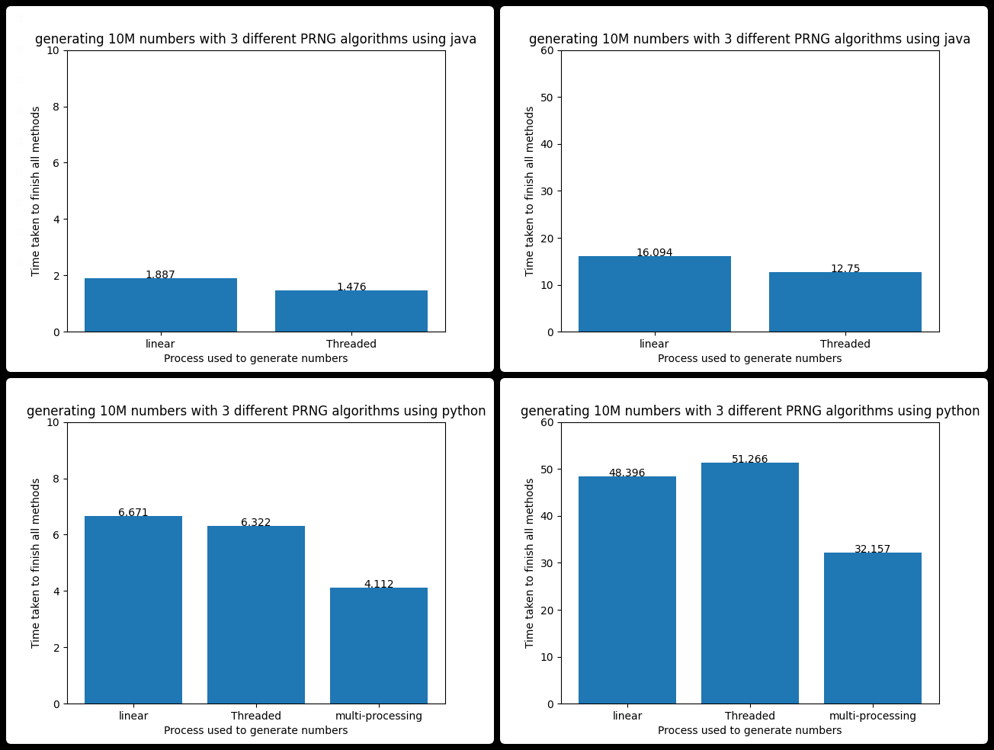
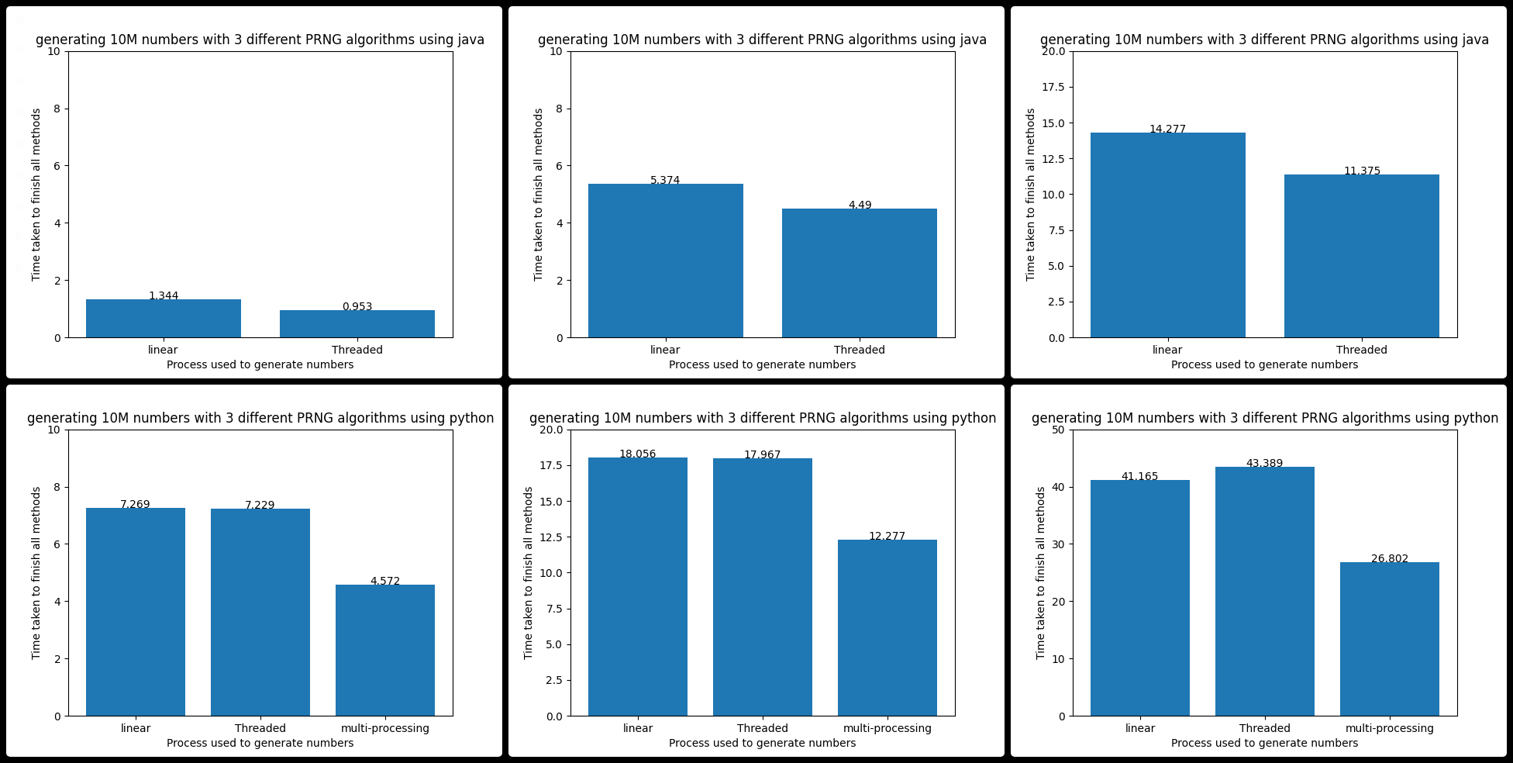
Time Data
TK Laptop, PI
ME Desktop, Laptop, PI
Notes:
Data is the average of 50 runs.
My laptop, pi 4
Java linear 3x faster
Java threaded 4x faster
His desktop
Linear Java 5x faster
Threaded Java 7x faster
Laptop and PI similar results to My laptop

Slide 8
Issues encountered
Java
Had to create another thread to monitor usage.
Python
GIL
Measuring memory
Unoptimized file writes

